Slide 1
Lessons Learned and Experienced Gained by CAT B Course
IHO – NIPPON FOUNDATION
ALUMNI SEMINAR
DAO QUOC KHANH

Slide 2
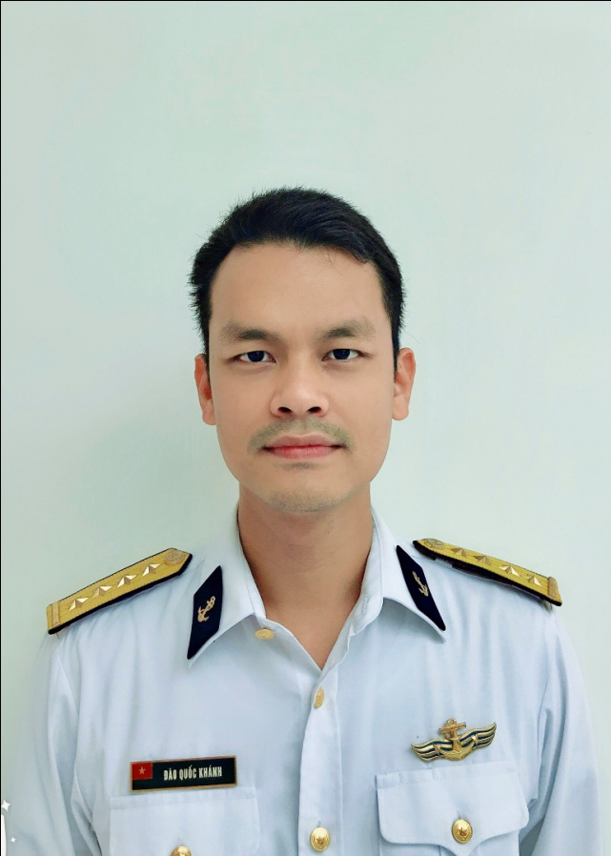
Self introduction
IHO – NIPPON FOUNDATION
ALUMNI SEMINAR
Name | DAO QUOC KHANH
Alumni year | 2014
Country | Vietnam
Organization | Vietnamese Hydrographic Office
Position/Job title | Deputy Head of Cartographic Section
Current job description | Managing a Team of cartographers and compilers for charting Vietnamese waters.
Please put your photo here!

Slide 3
My career path and projects / Achievements
IHO – NIPPON FOUNDATION
ALUMNI SEMINAR
Joint the Navy in 2010
Course on Electronic Navigational Chart, UKHO, March 2012, UK
CAT B Cartography, UKHO 2014, UK
Master of Cartography, Remote Sensing and GIS, Vietnam Science University, 2016, Hanoi, Vietnam
CAT A Hydrography 2018, NIH, GOA, INDIA

Slide 4
Lessons learned from CHART Course
IHO – NIPPON FOUNDATION
ALUMNI SEMINAR
Point of view from chart users
Comprehensive fundamental of chart construction
Charting procedures and data assessment for the Hydrographic Office
Arrangement and organizing a cartographic training

Slide 5
Suggestion for the future
IHO – NIPPON FOUNDATION
ALUMNI SEMINAR
Enhancing the network of NIPPON Foundation members in Cartography and Hydrography
Making smooth transition from S-57 ENC to S-101 ENC
Sharing maritime information for the safety of navigation

Slide 6
THANK YOU
IHO – NIPPON FOUNDATION
ALUMNI SEMINAR

